Slide 1

Course project: Minesweeper
Students:
Phạm Hoàng Minh
Phạm Công Tuấn
Trần Ngọc Tiến
Python 3.8
(PyQt5, Numpy)
Photoshop
02/2021 – 05/2021

Slide 2
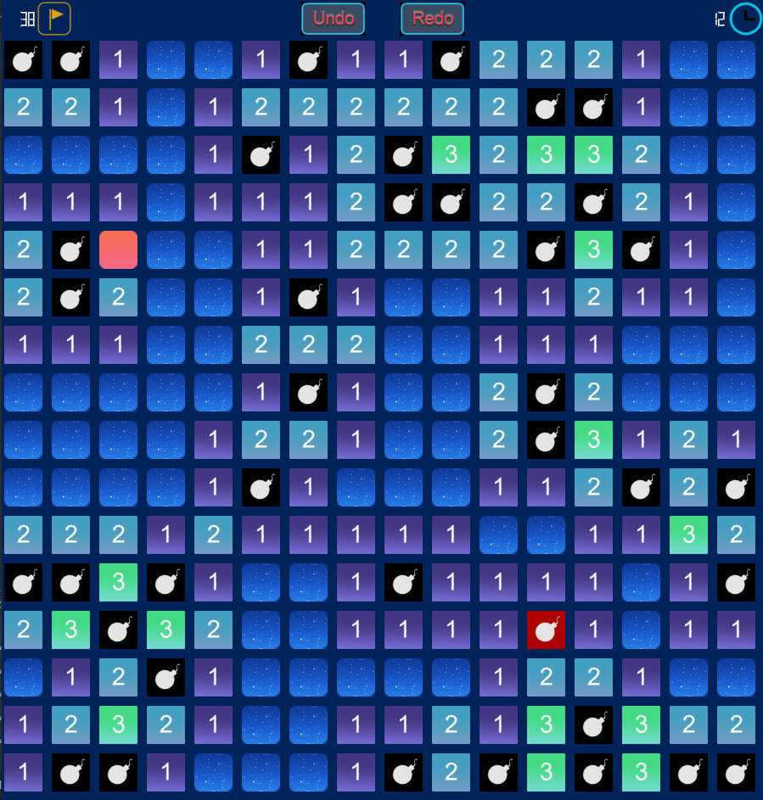
About the game

Slide 3
Features
We have everything…
Of the original game…
Plus…
Custom size board & Default size board available (up to 98 by 98, theoretically)
Undo/Redo steps
Organic self-growing modern UI
Graph Flowing (more details later)
Memory usage optimization
Executable file – No Python? No problem

Slide 4
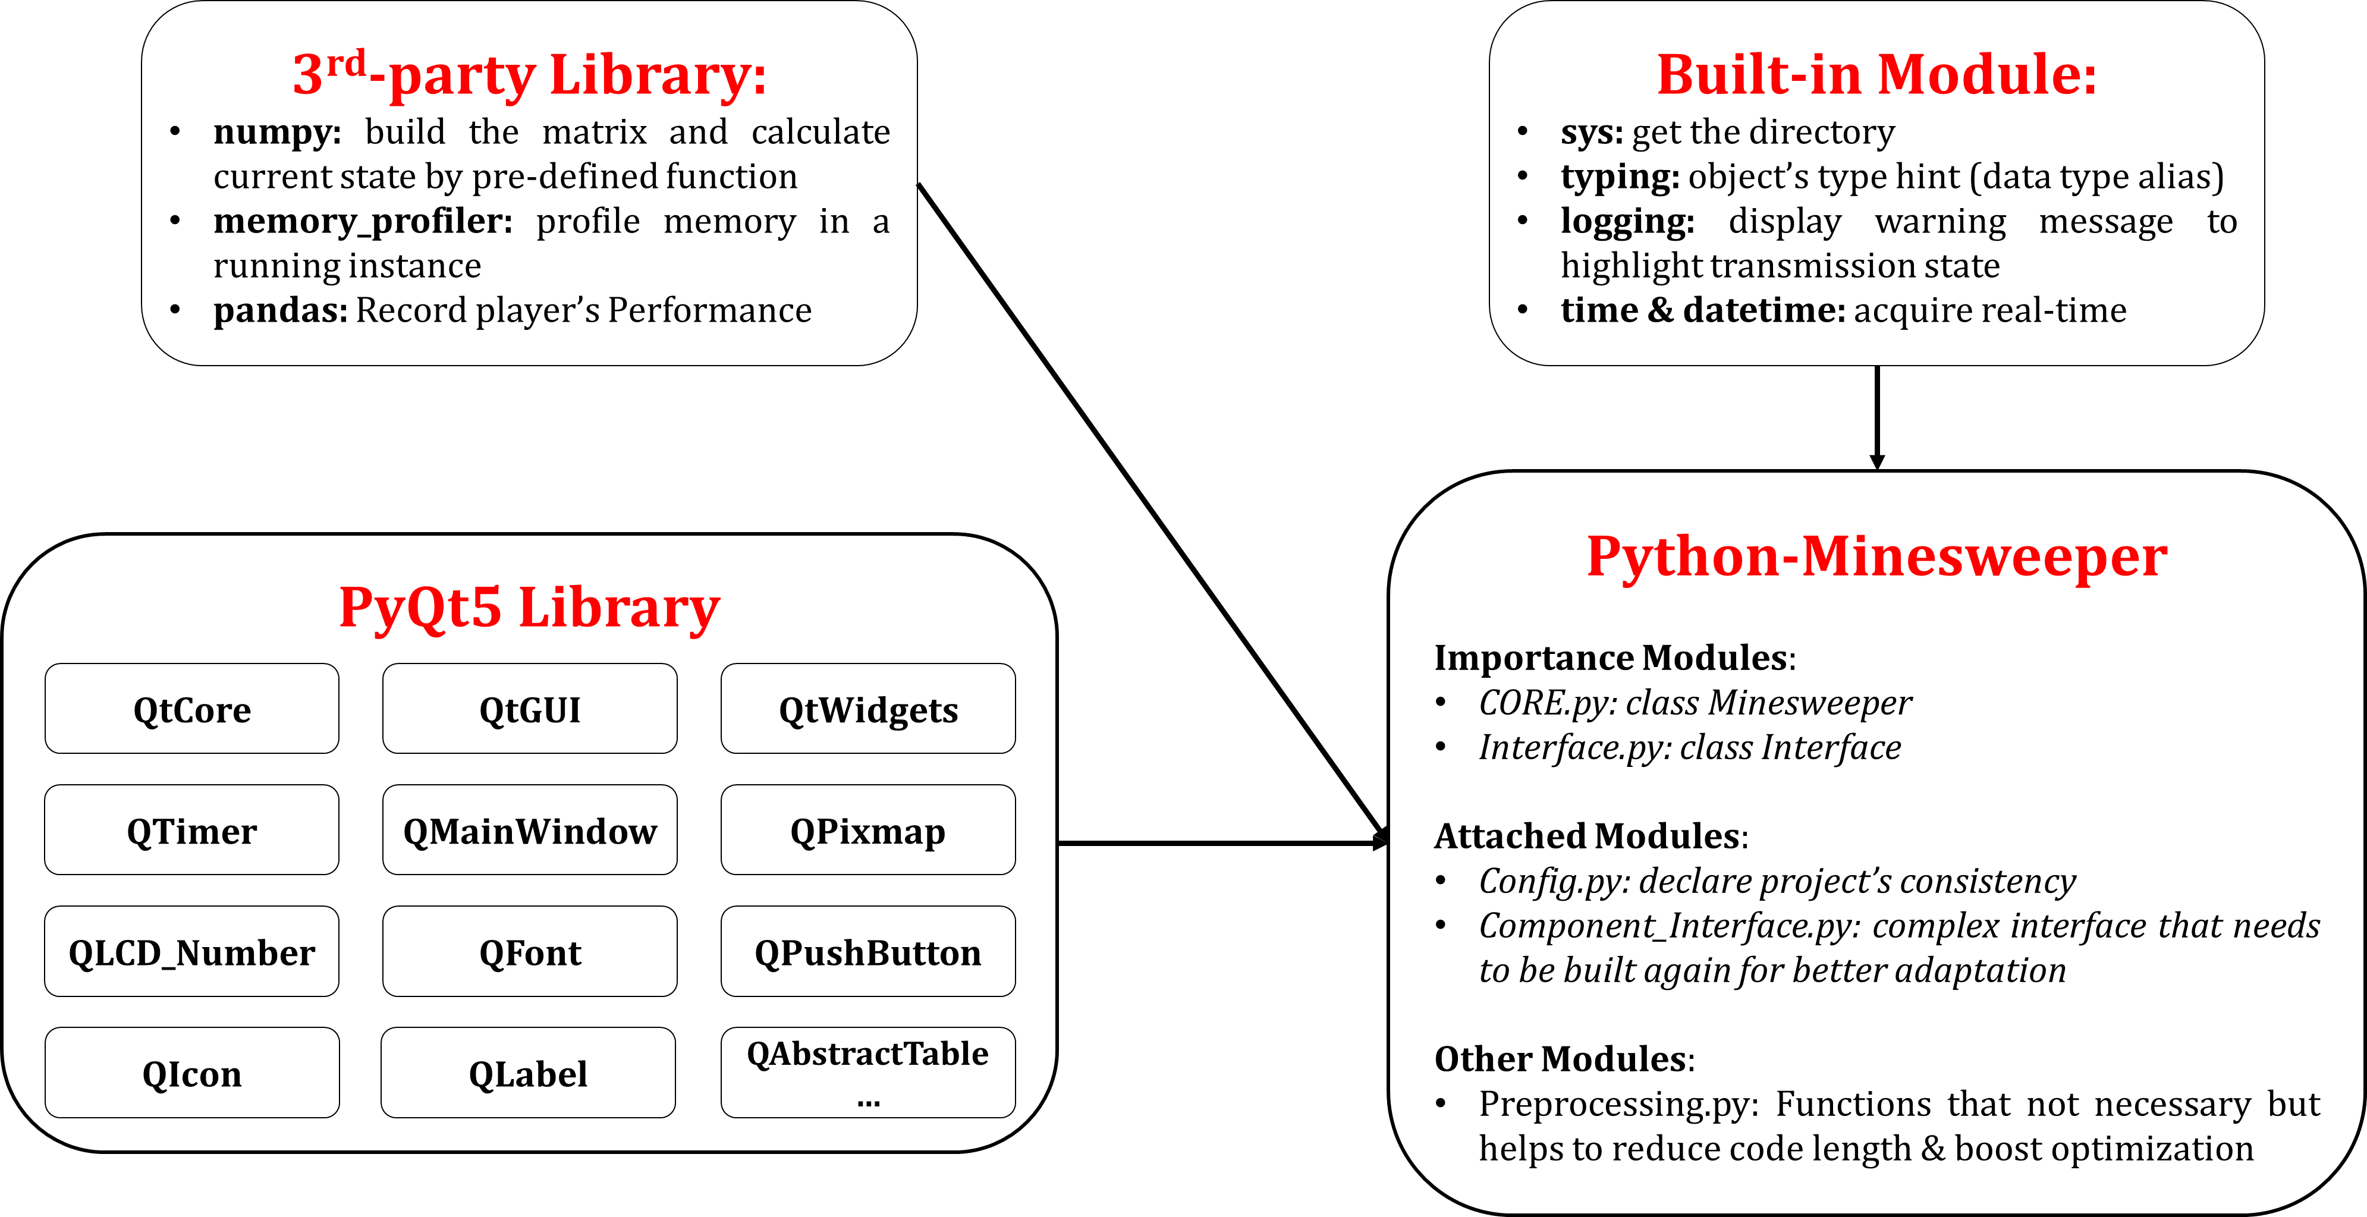

Slide 5
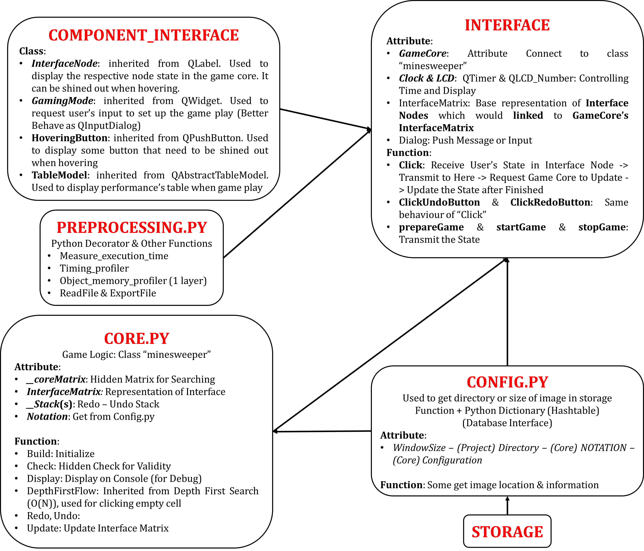

Slide 6
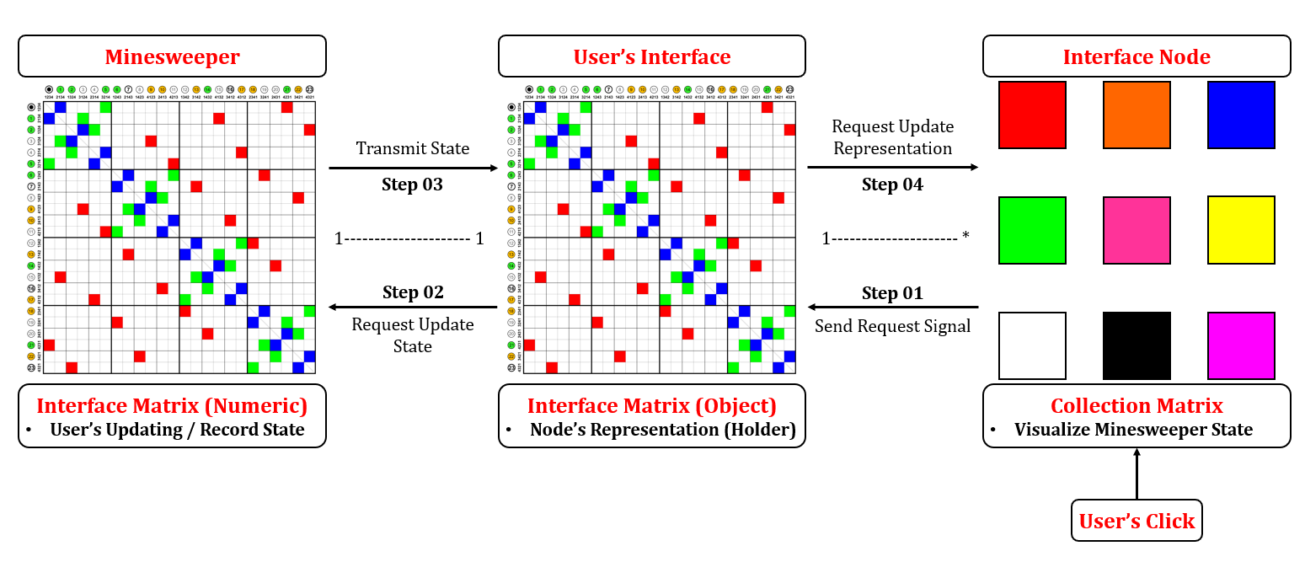

Slide 7
Features
List of Data Structure | List of Algorithm
Hash Table Graph Stack Matrix Data Frame | Binary Indexing Depth First Flow
Design Patterns
Singleton: ensure that each object was run by its own and dependency state was transferred by message Observer: Differed from normal situation when we need observer class to connect two object and transfer every messages, we used “Interface” as the Observer which binding the “minesweeper” logic

Slide 8
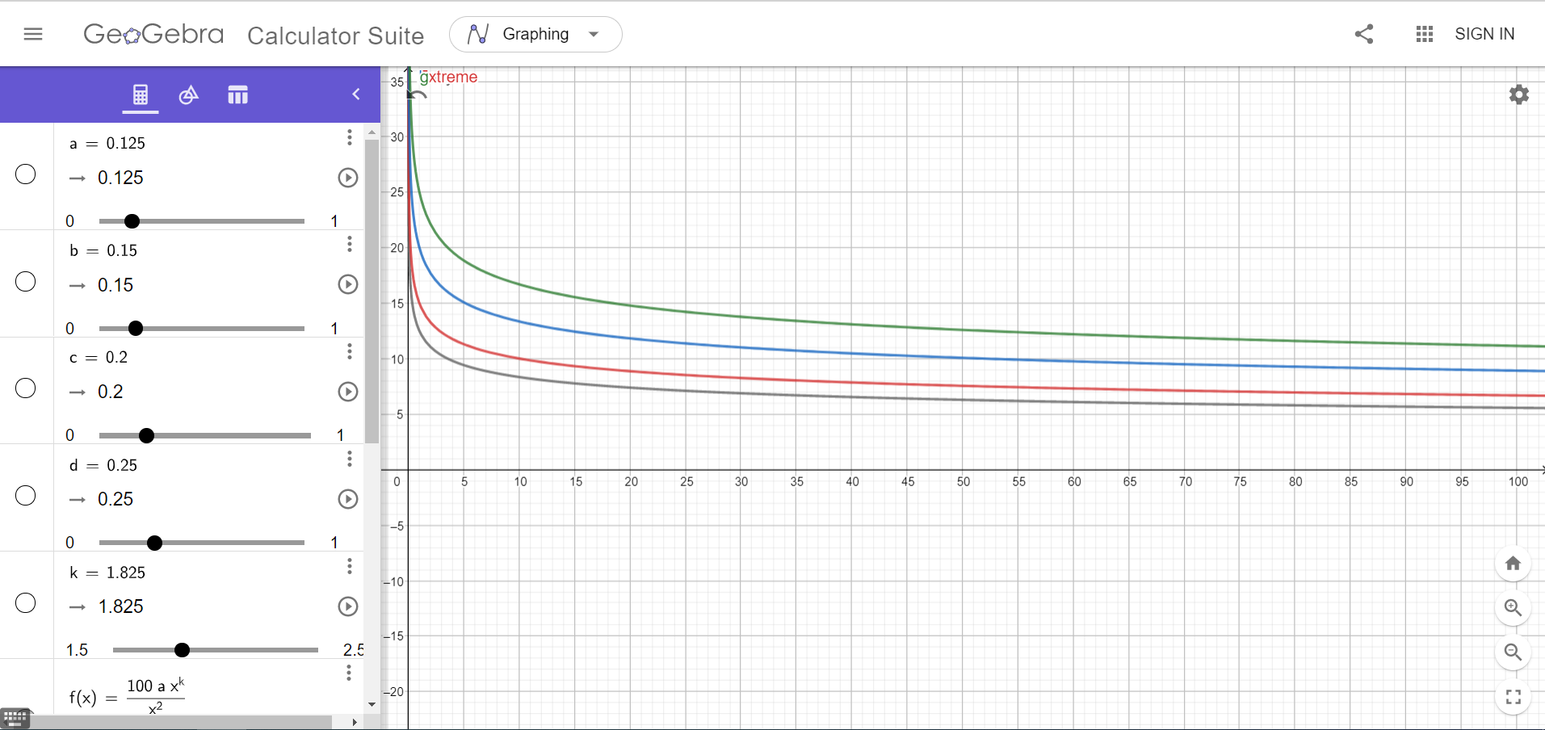
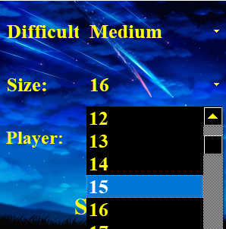
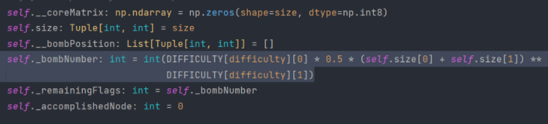
Features
Custom size board
Bomb estimation function

Slide 9
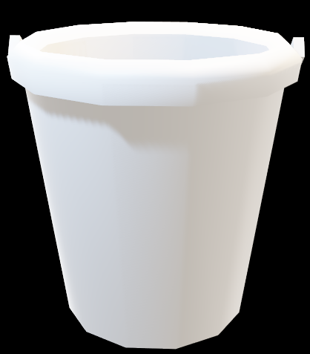



Features
Undo/Redo
Current state
Stack: First in Last out
Put current state into stack before making changes
When undo, retrieve the newest saved state (at the top of the stack)
The size of the stack determines how many times you can undo
The same logic for redo
Oldest state

Slide 10
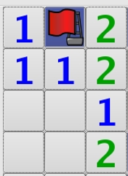
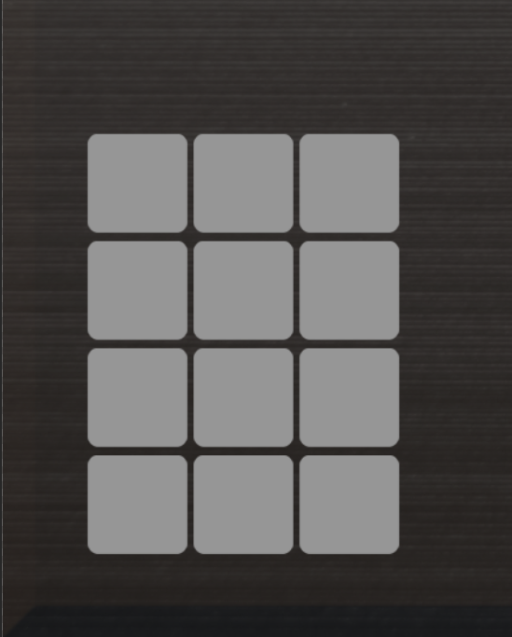
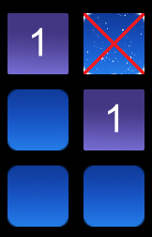



Features
GUI
Initial concept
Final product
Original

Slide 11
Features
Depth First Flow/
Graph Flowing
Based on Depth First Search
Aims to reduce time complexity
On clicking an empty, it would expand until it meets a boundary
With N = number of nodes, reducing memory size by N^2, reducing the real-time complexity of using adjacency matrix from N^2 to N

Slide 12
Features
Depth First Flow
Comparison (N: number of nodes)
Depth First Search (DFS) | Depth First Flow (DFF)
Time complexity O(N^2) | Time complexity O(N)
… | …
… | …

Slide 13
Timeline
Week of … | Progress | Contributors
Feb 15th | Form team and receive topic from the instructor | Minh, Tuấn, Tiến
Mar 1st | Find information about the game | Minh, Tiến
Mar 8th | Initialize the idea & style, create drafts | Minh, Tuấn
Mar 22nd | Create class diagram, improve the design of game elements | Minh, Tuấn, Tiến
Apr 5th | Begin to code game logic & GUI | Minh, Tuấn, Tiến
Apr 19th | Make progress in coding game logic & GUI | Minh, Tuấn, Tiến
May 3rd | Further improve the game | Minh, Tuấn
May 17th | Finishing the game & documents | Minh, Tuấn, Tiến
May 31st | Submission & Demo | Minh, Tuấn, Tiến

Slide 14
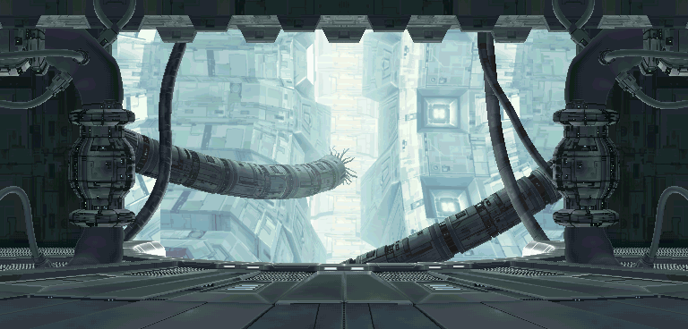
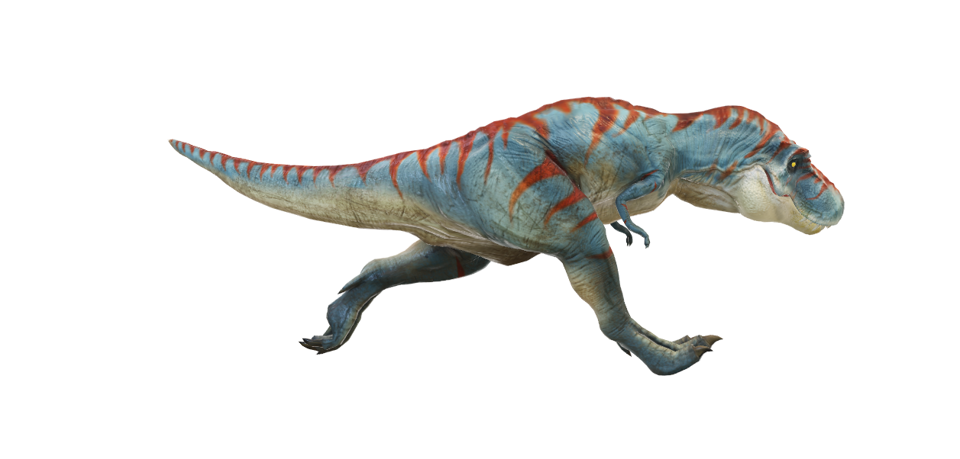
Demo

